Slide 1
Navigability: An Introduction Subsistence Resource Commission Spring 2026 Meeting
Gavin DeMali, National Park Service Navigable Waters Specialist

Slide 2
Overview
Navigability for title purposes is a legal construct for determining ownership of submerged lands. States own submerged lands of navigable waters.
Defined by a long history of caselaw precedent
Assessed on a case by case and sometimes segment by segment basis for individual waterbodies
Navigability is not the same as boating in general

Slide 3
Overview
Navigable waters include all those that are tidally influenced (coastal waters) as well as those inlands waters that are “navigable in fact”
Definition of “navigable in fact” comes from a long history of caselaw precedent, and changes as new precedents are set.
A valid, pre-statehood federal withdrawal can defeat state ownership of submerged lands.

Slide 4
Background
Upon statehood (January 3, 1959 for Alaska) states automatically receive ownership of the submerged lands beneath navigable waters.
Equal Footing Doctrine, stemming from Art. IV, sec. 3 cl. 1 of Constitution
Constitutional law principle that new states enter the union with the same rights afforded to the original 13 states. One right is the ownership of the submerged lands of navigable waters.

Slide 5
Background
Submerged Lands Act, 82 Stat. 1146
A 1953 law that codified state ownership of the submerged lands of navigable inland waters.
Navigability is defined by federal law and has evolved over time. It continues to change with additional court cases.

Slide 6
Navigability: The “Classical” Definition
The Daniel Ball, 77 U.S. (10 Wall.) 557 (1870)
“Those rivers must be regarded as public navigable rivers in law which are navigable in fact. And they are navigable in fact when they are used, or are susceptible of being used, in their ordinary condition, as highways for commerce, over which trade and travel are or may be conducted in the customary modes of trade and travel on water.”
Key Elements:
Used or susceptible to being used
In “ordinary condition”
Commerce
On water- therefore not frozen
Notes:
Emphasize customary modes of trade and travel on water

Slide 7
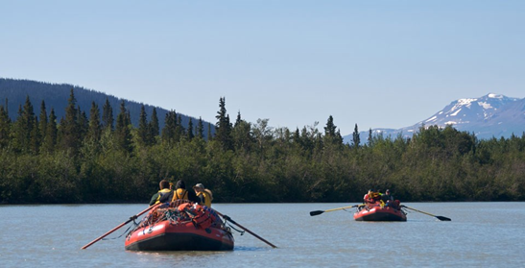
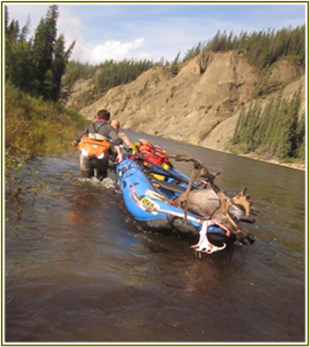
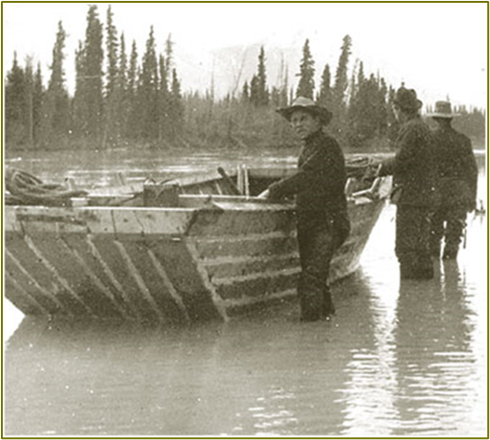
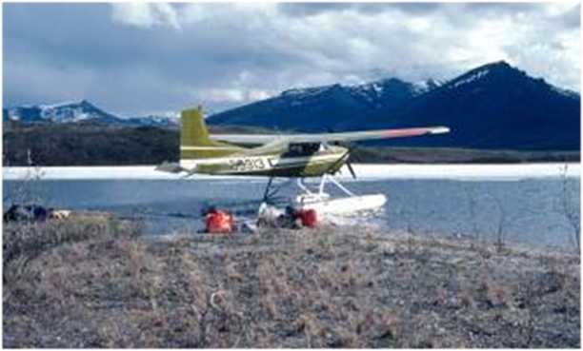
Further Precedents
The Daniel Ball definition was modified over time by later court cases.
These cases addressed things such as:
Portages not necessarily defeating navigability
Floatplane landings along not being proof of navigability
Guided recreational float trips can demonstrate susceptibility
Affirming the practice of segmenting waterbodies when making determinations
Providing clarification on what sorts of watercrafts were customary at the time of statehood
Notes:
Highway of commerce- requires that it is usable on a regular, consistent basis.
Portages or other obstacles/obstructions don’t inherently defeat navigability
Does not need to be open to navigation at all points in year, just reliable open water season
a river’s use “need not be without difficulty, extensive, or long and continuous” for the river to be a highway for commerce. Oregon v. Riverfront Protection Assoc., 672 F.2d 792, 795 (9th Cir. 1982).
when passage is limited to times of temporary high water or if boats must be repeatedly dragged or carried, then it is likely non-navigable.

Slide 8
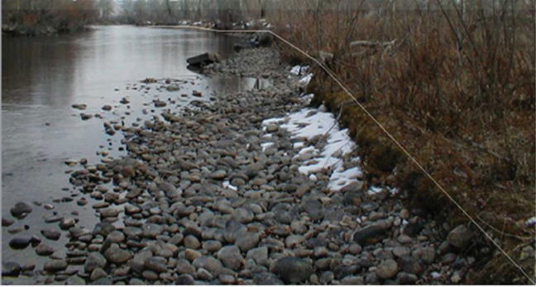
The Submerged Lands Act
Submerged Lands Act, 43 USC Chapter 29 SS 1301-1315
“all lands within the boundaries of each of the respective States which are covered by nontidal waters that were navigable under the laws of the United States at the time such State became a member of the Union, or acquired sovereignty over such lands and water thereafter, up to the ordinary high water mark as heretofore or hereafter modified by accretion, erosion, and reliction”
Conditions at time of Statehood
Ordinary high-water mark as boundary
Notes:
Emphasize “at the time of statehood”, connect to the customary crafts clause of the Danial Ball definition to highlight how floatability in modern crafts is not definitive proof of navigability.

Slide 9
Navigability Defined
A waterbody is navigable if it is used or is susceptible of being used as a highway for trade, travel, and commerce in the waterway’s natural and ordinary condition (at the time of statehood) in crafts customary at statehood (or crafts meaningfully similar to those customary at statehood).

Slide 10

Who Determines Navigability?
Navigability for title purposes is a legal question, ultimately settled in federal court.
Only the courts can confer legal title.
Bureau of Land Management (BLM) makes administrative navigability determinations in support of land conveyances.
Required by the Native Allotment Act, ANCSA, and the Alaska Statehood Act as a part of the land selection process.

Slide 11
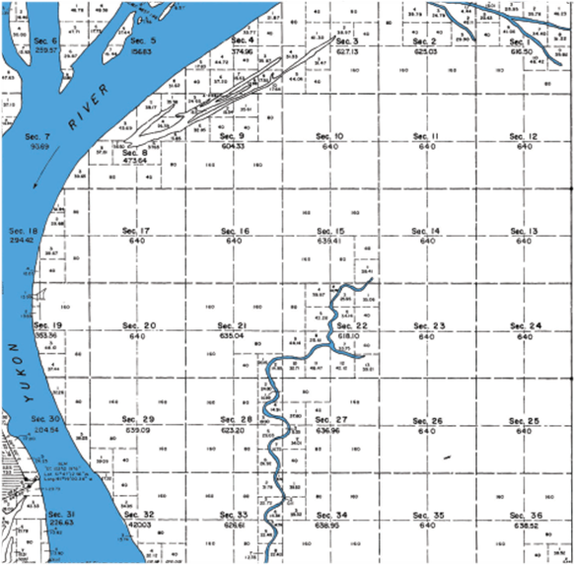
BLM Navigability Determinations
BLM is required to make navigability determinations on selected lands. (Federal Land Management Policy and Management Act, 43 U.S.C. Sec. 1701 et. seq.)
BLM is required to identify navigable waterbodies for waters less than meanderable size (rivers/streams less than 198ft wide, lakes less than 50 acres) on selected lands.
BLM determinations can be updated,
except those made in support of and
incorporated into ANCSA conveyances.
Notes:
Federal Land Management Policy and Management Act, 43 U.S.C. Sec. 1701 et. seq.

Slide 12
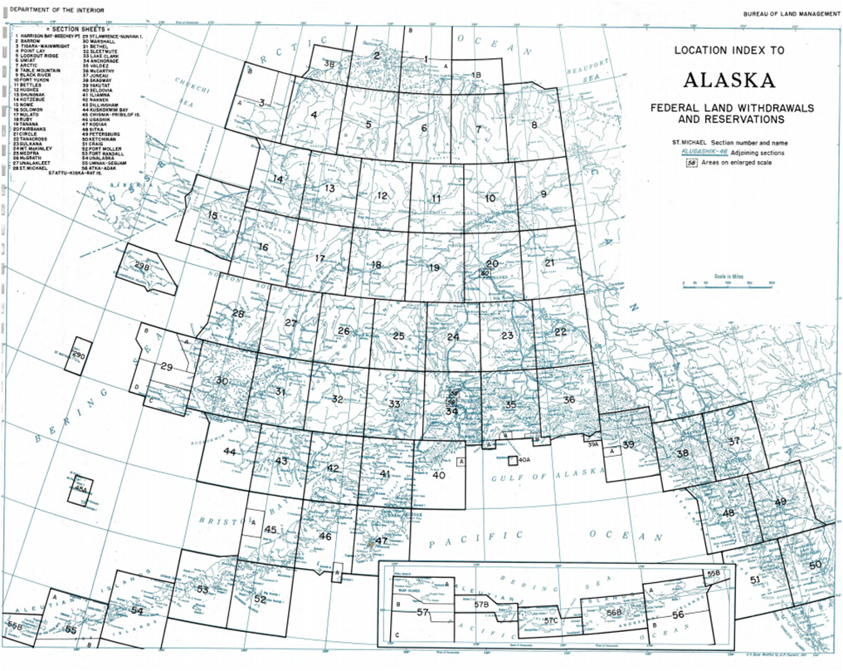
Factors in Determining Navigability
Existence of pre-statehood withdrawals
Evidence of use or susceptibility for use as a highway for conducting trade, travel, or commerce in the waterway’s natural and ordinary condition in crafts customary at the time of statehood.
Historical evidence (use)
Physical characteristics (susceptibility)
Historical evidence is often clearest

Slide 13
Elements of Historical Evidence
Use of any watercraft as well as the location and extent of use.
Craft style, materials, cargo capacity, hull length, draw depth, method of propulsion, etc.?
Where on the waterbody, how far upstream?
Activities in proximity to the waterbody.
Activities that could have used waterbody as means of facilitating commerce, e.g., trapping along a river.
Noted features or characteristics of the waterbody.
Obstructions and their location, water depth, stream gradient, discharge, flow rate, etc.
Notes:
Include examples, such as 1979 Kandik appeal criteria. Emphasize crafts customary at the time of statehood and meaningful similarity.

Slide 14
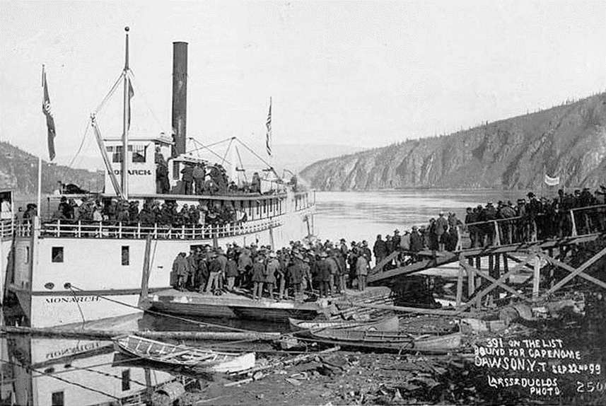
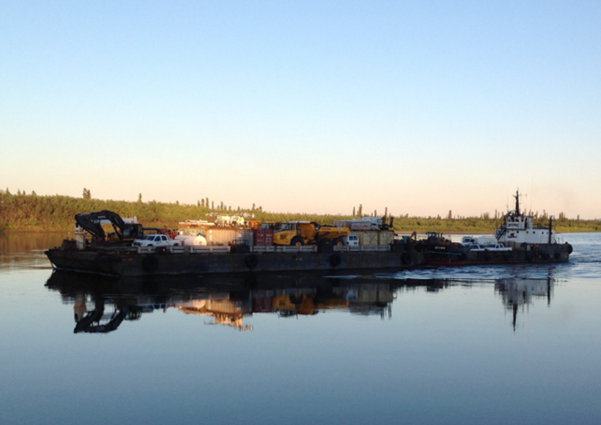
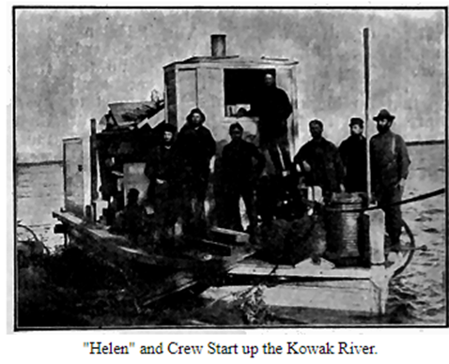
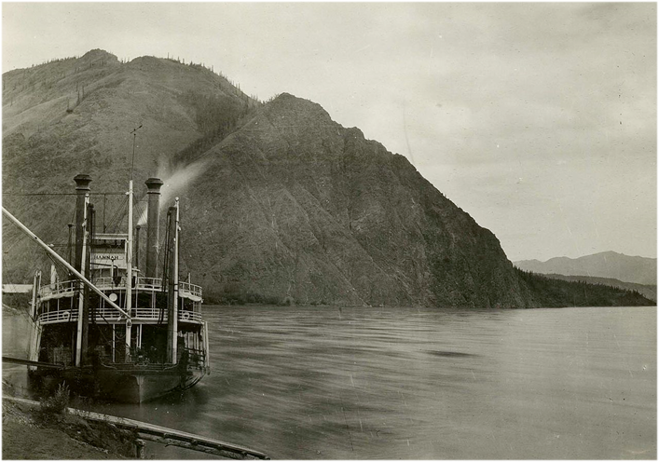
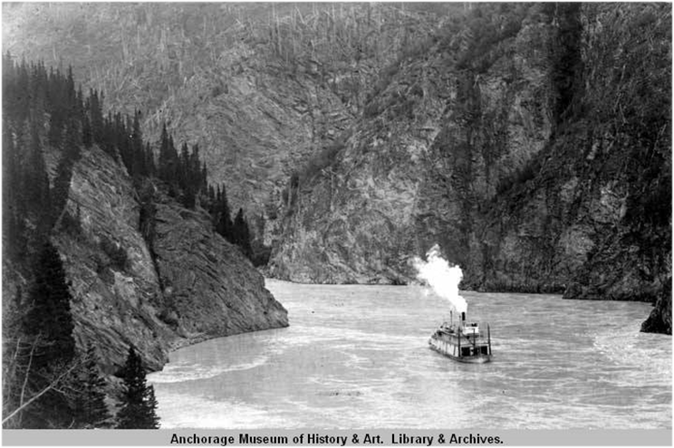
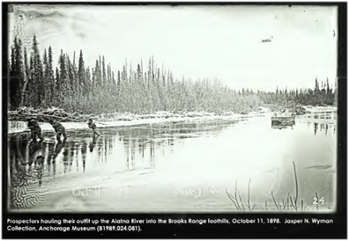
Elements of Historical Evidence

Slide 15
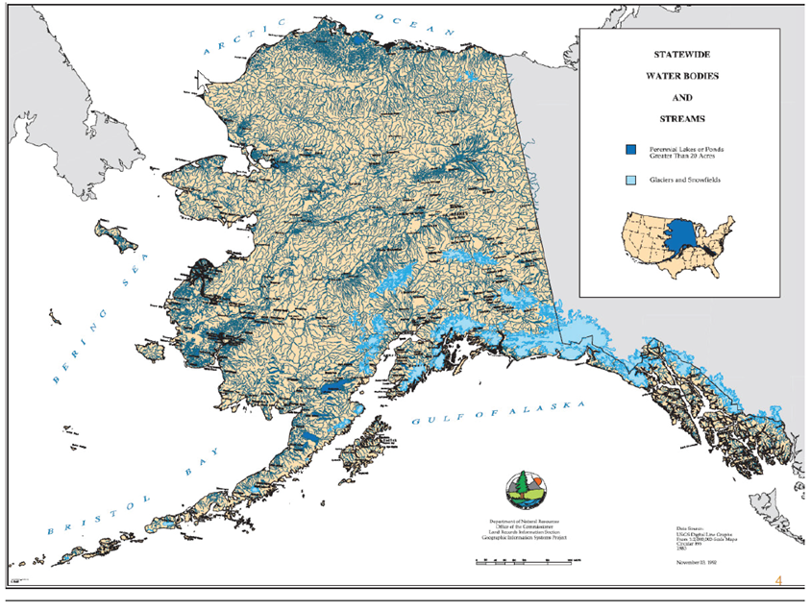
Physical Characteristics
If there is a lack of historical evidence, physical characteristics could indicate the waterbody’s susceptibility for being navigable.
Due to the remoteness of most Alaskan waterbodies, there is often no historical evidence, and susceptibility must be considered.

Slide 16
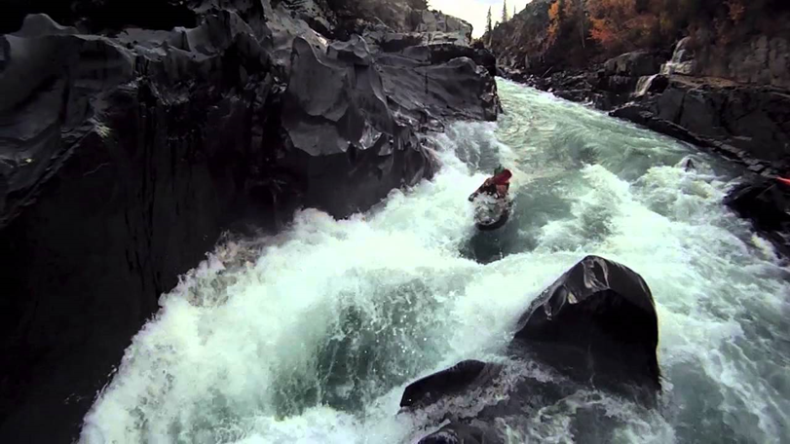
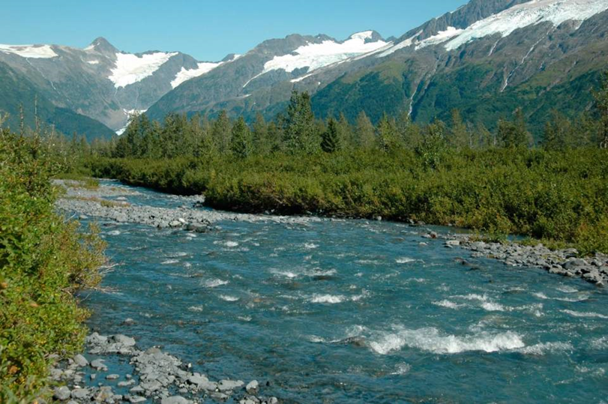


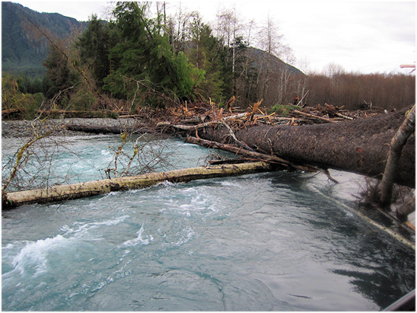
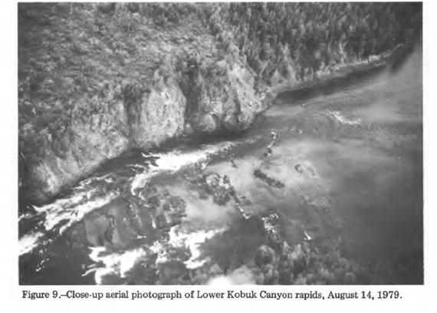
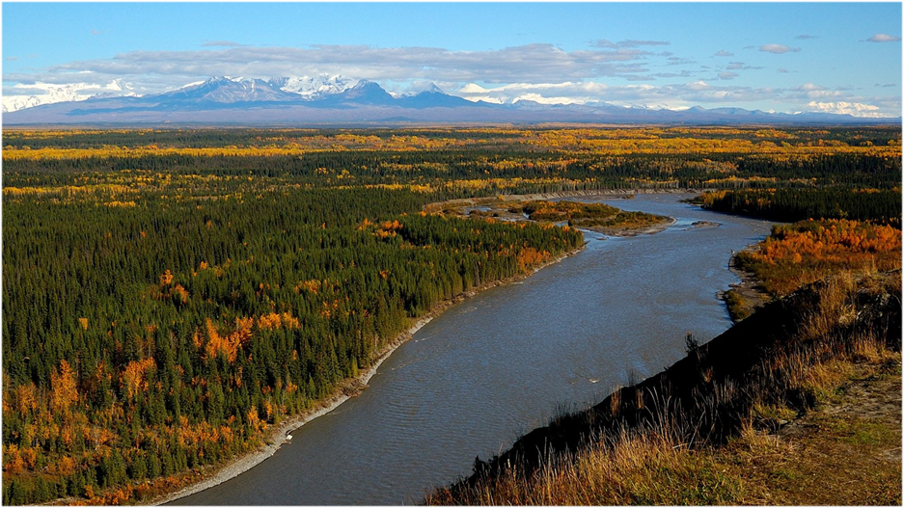
Physical Characteristics

Slide 17
How is Ownership Resolved?
There are 2 mechanisms for resolving the dispute over title.
Recordable Disclaimer of Interest (RDI): Administrative
If both parties can agree that a waterway is navigable, the U.S. can disclaim its interest through an administrative process known as an RDI.
Quiet Title Action (QTA): Judicial
If both parties cannot reach a resolution, title can be adjudicated via a Quiet Title Action.
Notes:
Taking a management action on an undetermined waterway that the State asserts as navigable could give the State standing to file a Quiet Title Action. Discuss grounds for a QTA

Slide 18
Recordable Disclaimer of Interest (RDI)
Parties can apply for an RDI through BLM.
Applicant submits legal description of the submerged lands claimed, and any evidence supporting navigability.
BLM considers this information, decides to either approve the application and disclaim the U.S. interest or to reject the application.
Rejected applications can be appealed.
Notes:
The State has argued in the past that the RDI process is too cumbersome, a contributing factor in their decision to pursue a more aggressive strategy

Slide 19
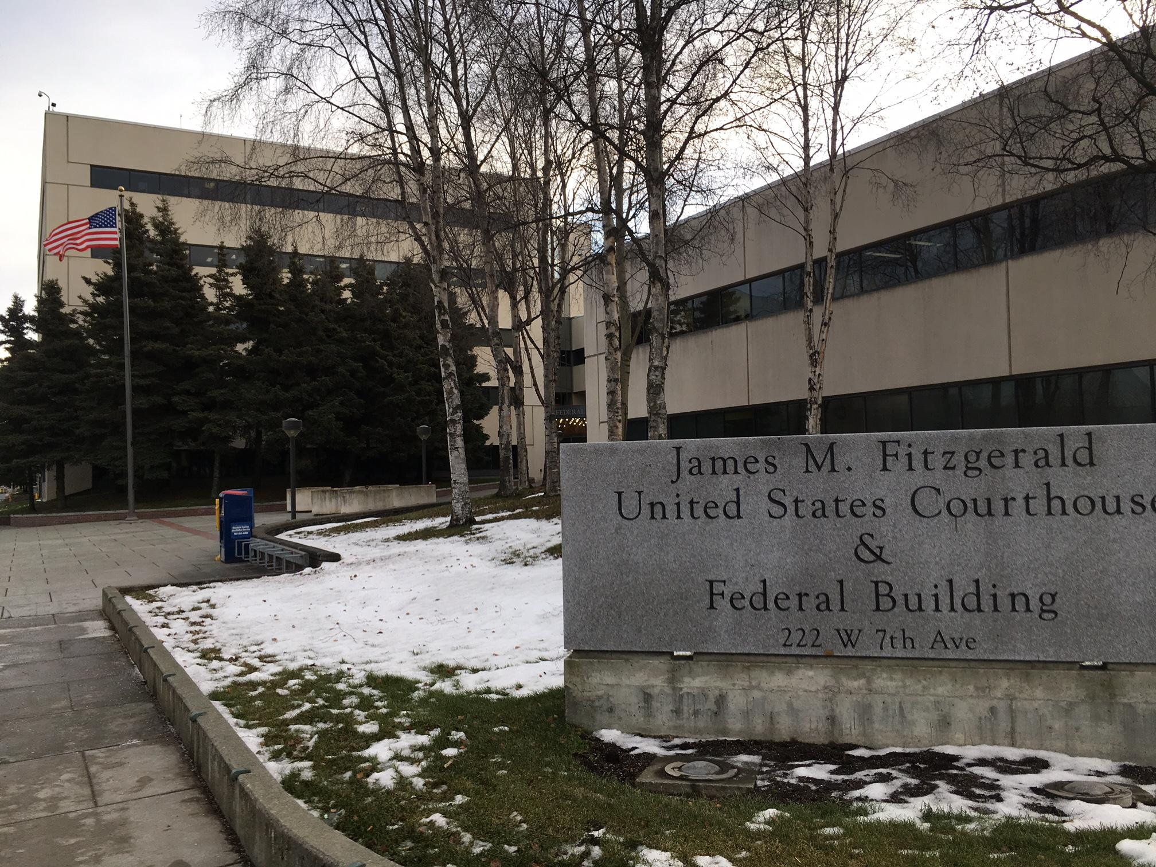
Quiet Title Actions
If the State and U.S. disagree on navigability, State can file a Quiet Title Action in federal district court to decide title.
Must submit a 180-day notice of intent to the U.S. before complaint can be filed.
Once notice period has lapsed, State not required to file complaint. In some instances, State will wait even longer before filing.
There are several ongoing QTA’s,
across the state.

Slide 20
Navigability and Subsistence
Federal subsistence regulations still apply of navigable waters within and adjacent to ANILCA designated conservation system units.
While the Sturgeon decision denied NPS’s ordinary regulatory authority over navigable waters within ANILCA CSU’s, in footnote 2 the Court refused to address subsistence regulations as they were not specifically at issue in the case.

Slide 21
Navigability and Subsistence
Sturgeon had left the Katie John precedent of federal subsistence fishing regulation applying to navigable waters open to challenge.
However, the Supreme Court recently refused to hear a challenge to this precedent, leaving the Katie John rulings standing as law.

Slide 22
Questions?

