Slide 1
The Stories We Tell and the History We Know

Slide 2
Game Time! Anachronism Masters
Write down 4 things in this classroom that would make a Victorian child faint.
Once everyone is ready, take turns reading your answers for the class.
No laughing! If you laugh or giggle give yourself one point. (Snickering counts too!)

Slide 3
Anachronism Masters
What is today’s date?
Victorian children would have been alive between the 1830s through the 1910s, the Victorian Age.
How many of the objects that you listed have only existed after the 1910s? These objects are anachronistic to a Victorian Child and might cause them to faint!
How many laughing points did you get? If you laughed less than 4 times, you are an Anachronism Master!

Slide 4
Anachronism
Anachronism - To take an idea or term from one point in history, and claim it was present in another time is called an anachronism. Such as a fun game where a “Victorian Child” might faint if they saw a smart phone!
Outside of games, anachronisms are mistakes when talking about or studying history. But responsible writers and historians must check their claims with good resources. If they do not, it can mislead people to believe false or incomplete history. Sometimes anachronisms are created on purpose. Let’s look at a few examples.

Slide 5
Anachronisms of the U.S. Civil War
After the U.S. Civil War Confederate sympathizers, veterans, and their families developed different names for the conflict. Some of those include: War for Southern Independence, War of Northern Aggression, War of Rebellion, War Between States, and popularly, the Lost Cause.
These names are anachronistic and inaccurate, but became incredibly common in the in the late 1800s through the 1900s. But why?

Slide 6
The Myth of the Lost Cause
The Lost Cause is a revised version of U.S. Civil War history. The story of the Lost Cause includes many plot points. One is that the Confederacy fought a war for states’ rights, not slavery. Another point is that the Confederates fought an honorable war. The Lost Cause blames the war on U.S. military aggression but praises the Confederate secession. After the Civil War, Confederate sympathizers considered antebellum Southern society superior to Northern. This nostalgic view ignored the violent oppression of enslaved Africans. Instead, slavery is presented as charitable and slaveholders as kind. The Lost Cause claims that the Confederacy was not truly beaten. Rather, overwhelmed by the resources of the U.S. Army. The Lost Cause casts the antebellum society as a victim rather than an oppressor.
“Memorialization of Robert E. Lee and the Lost Cause.” Arlington House. NPS. 2021. Memorialization of Robert E. Lee and the Lost Cause - Arlington House, The Robert E. Lee Memorial (U.S. National Park Service) (nps.gov)
James Horton. “Confronting Slavery and Revealing the “Lost Cause.” NPS. 2017. Confronting Slavery and Revealing the "Lost Cause" (U.S. National Park Service) (nps.gov)

Slide 7
The Effects of the Lost Cause Myth
The Lost Cause creates distance between chattel slavery and the motives of Confederate states. While slavery was not the only cause of the Civil War, it was central. States' rights only mattered where chattel slavery was at risk of ending.
By focusing on the story of the Lost Cause, historians and researchers missed chances to explore additional history. For decades other history was deferred in favor of White Confederate defense in the Lost Cause.

Slide 8
Deferred History
Deferred history - Portions of human history ignored in favor of more dominant narratives. In the U.S., Indigenous, Women’s, and Black history often fall in this category. Many historians focused of prominent figures in history who were often White men, until recent decades. For example, military and political history are often told more often than local history. Sometimes history is deferred when the truth is unfavorable.
Many historians and historic sites are trying to bring deferred histories into public knowledge. In Henderson County, the Carl Sandburg Home is diving into the deferred histories of the site. Check out a couple of deferred histories like The Kingdom of the Happy Land and the Ellison Adger Smyth of Connemara.

Slide 9
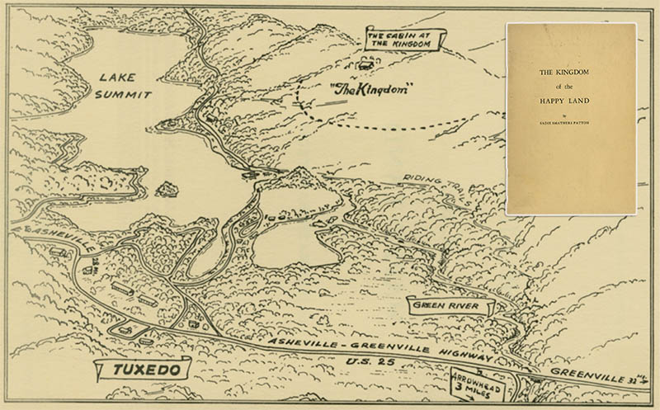
Kingdom of the Happy Land: The Journey
After the Civil War freed African Americans found themselves with new choices. Many chose to leave the places they had been enslaved and seek new starts in new places.
Between 1864 and 1867, a group of about 50 freed people decided to look for a new place to live. Many historians agree the group's starting point was a plantation in Mississippi. As they walked Northeast through Alabama, Georgia, and South Carolina to North Carolina, more people joined. Finally, the group landed in Henderson County, in the hills above Green River.
The Black settlement organized around the idea of "One for all, and all for one."
This map offers the layout used by local historian Sadie Patton in her 1957 pamphlet, The Kingdom of the Happy Land.
Map. Sadie Smathers Patton. The Kingdom of the Happy Land. Ashville: Stephens Press. 1957.
Anna Whisnant and David Whisnant. Black Lives and Whitened Stories: From the Lowcountry to the Mountains. Carl Sandburg Home National Historic Site. Historic Resource Study. NPS. 2020. 231-234.

Slide 10
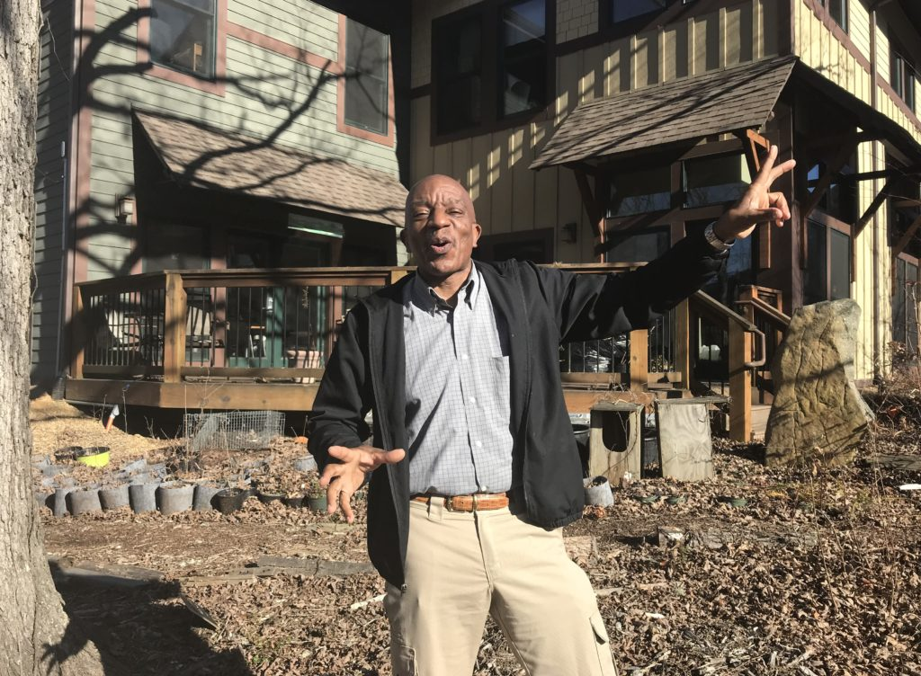
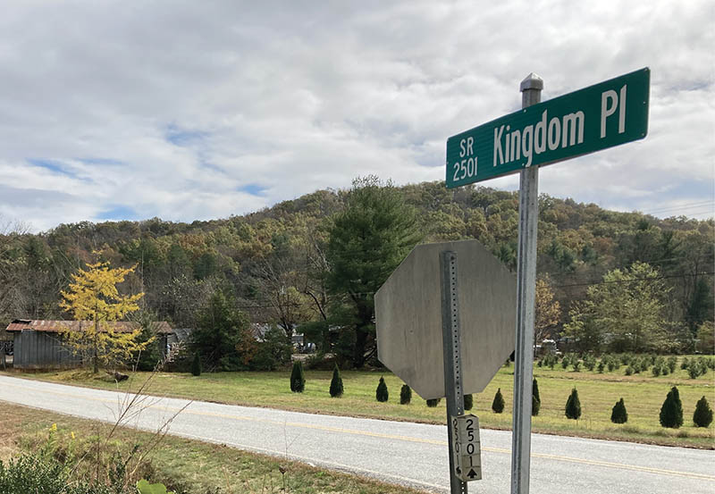
Kingdom of the Happy Land: The Settlement
Historians often describe the Kingdom as communal and utopian. The Kingdom was led by a king and a queen and had a common treasury. The residents were farmers and developed herbal treatments. They sold a treatment called Happy Land Liniment in nearby towns like Hendersonville. Money from the town's labor went into the common treasury. The treasury was intended for purchasing the land they had chosen as their home. In the Reconstruction era, owning land protected Black Americans from sharecropping. The Kingdom of the Happy Land continued through the 1910s. But as residents aged and young people moved away, the utopian community gradually disappeared by 1918.
There are many versions of the Kingdom's history. The lack of records and differences in details makes the history of the settlement difficult to outline. But similarities and lasting heritage has kept the Kingdom's memory alive. Today, research by students, the Black History Research Committee of Henderson County, local historians and the National Park Service, continues to bring this story into the present.
Ronnie Pepper is a local storyteller who has retold the story of the Kingdom of the Happy Land from an African American perspective and contributed to the conservation of Black heritage in Western North Carolina.
This state road sign for Kingdom Place, is a modern reference to the Happy Land.
Whisnant and Whisnant. Black Lives and Whitened Stories. Carl Sandburg Home NHS. National Park Service. 2020. 231-234.
Photos. Jon Elliston. “The Happy Land” WNC Magazine. Winter Issue 2021. https://wncmagazine.com/feature/happy_land
Danielle Dulken. “A Black Kingdom in postbellum Appalachia.” Scalawag. https://scalawagmagazine.org/2019/09/black-appalachia-kingdom/

Slide 11
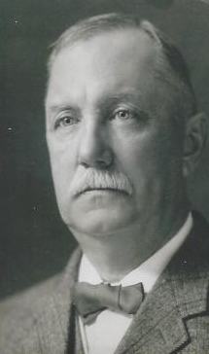
Ellison Edgar Smyth and the Civil War
Ellison Smyth purchased Rock Hill in 1900. He renamed it Connemara for the family's Irish ancestry. The Smyths retreated to Connemara in the summers but in 1925 Smyth moved to the property permanently. Before this, Ellison Smyth was a volunteer for the Confederate Army in 1864. During Smyth's time in the Confederacy, John Dent and Merriman Johnson, both enslaved, were forced to go with him. Johnson received a pension due to 1923 state legislation. The law recognized African American efforts as servants in the Civil War. Sixty years after emancipation, "servant," was still a euphemism for an enslaved person.
Whisnant and Whisnant. Black Lives and Whitened Stories. Carl Sandburg Home NHS. NPS. 257-261.
“Smyth Family at Connemara.” Carl Sandburg Home NHS. NPS. Oct. 22, 2021. https://www.nps.gov/carl/learn/historyculture/stories.htm
“The Story of Ellison A. Smyth and Pelzer Manufacturing. Dec. 16, 2019. https://www.southcarolinamanufacturing.com/ellison-adger-smyth/

Slide 12
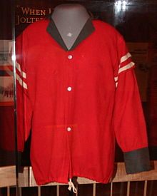
“Captain” Smyth and the Red Shirts
Smyth had a powerful role in South Carolina's industrial development and racial oppression after the Civil War. Smyth was a member and leader of multiple "rifle clubs." He received the title "Captain," in this role. By 1876 Rifle clubs organized across South Carolina into the "Red Shirts" Clubs. These groups of armed men rode through the state violently intimidating Black voters. They also committed many forms of fraud to return the Democratic Party to power that year. By 1898 the violence of the Red Shirts would spread to North Carolina as well and impact state elections.
"Red Shirt" uniform, at the North Carolina Museum of History, 1898-1900.
Whisnant and Whisnant. Black Lives and Whitened Stories. Carl Sandburg Home NHS. NPS. 261-265.
James L. Hunt. “Red Shirts.” Ncpedia. 2006. https://www.ncpedia.org/red-shirts
Photo. “Red Shirts.” Wikipedia. https://en.wikipedia.org/wiki/Red_Shirts_(United_States)

Slide 13
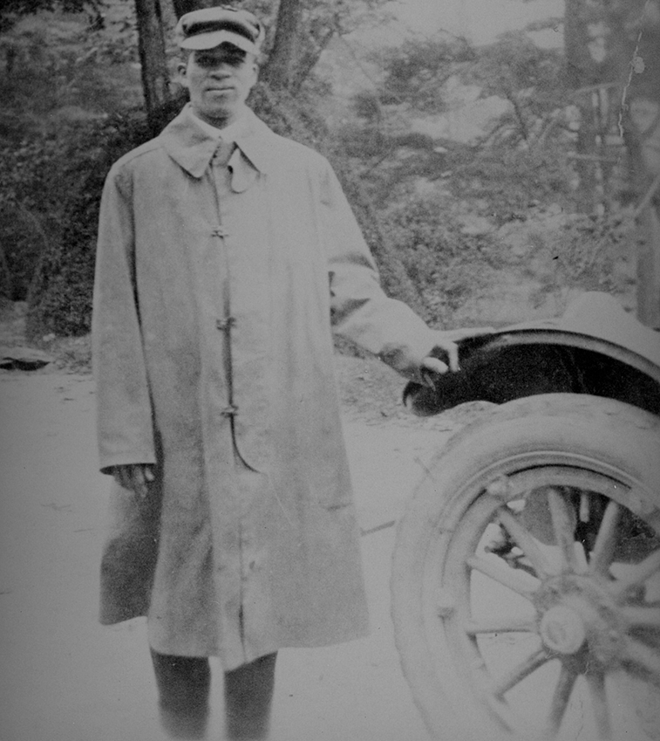
James Fisher
Previous history of the Smyth family at Connemara focused largely on Ellison Smyth's experience as an industrialist. Recently historians have pushed for more honesty and clarity in the history of the site. Bringing attention to history like Smyth's and the Kingdom's, we can learn more about our history than we could before. We can also ask new questions about history we thought we already knew.
James Fisher, an African American man, worked for the Smyth family from around 1911 and moved to Flat Rock with the family where he lived until his death in 1978. By 1930 his wife and children also lived in Flat Rock and worked for the Smyth's. Fisher was interviewed by the National Park Service staff in 1975 about his time working for Ellison Smyth. This interview is excellent for historians research.
But knowing about the Smyth family's history of racial politics raises questions about the interview.
Did Fisher feel safe enough to answer questions with full honesty?
Did Fisher withhold events from the record due to possible caution or a wish to protect his family?
James Melvin Fisher, 1923. Fisher was born between 1891 or 1894 and died in 1978.
“Black History at Rock Hill/Connemara.” Carl Sandburg Home NHS. NPS. April 8, 2022. https://www.nps.gov/articles/000/carl-black-history.htm

Slide 14
Think About It Write About It
Think About It: Place yourself in James Fisher’s shoes. It is 1975 in Western North Carolina. You are an African American person, who previously worked for Ellison Smyth, a leader of violent Red Shirts of South Carolina. You have been invited to interview with the National Park Service. The person interviewing you is nearly a stranger. Your family still lives in the area.
Write About It: Consider the situation and describe your thoughts, choices, and reactions. What might go through your mind? Would you be willing to interview? What factors might influence your answers? Would the person interviewing you might influence your answers? Would you be worried or would you feel fine?

