Slide 1
Chattel Slavery and Migration:
How Colonization and Enslavement in the Lowcountry Led to Emigration to the North Carolina Mountains

Slide 2
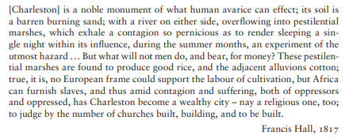
Document 1
Peter McCandless, Slavery, Disease, and Suffering in the Southern Low Country (New York: Cambridge University Press, 2011), 3.

Slide 3
Document 2
“Rice Production in the United States,” Wikipedia, May 31, 2020, https://en.wikipedia. org/w/index.php?title=Rice_production_in_the_United_States&oldid=959969845
The colonies of South Carolina and Georgia prospered and amassed great wealth from Asian rice planting, based on the slave labor and knowledge obtained from the Senegambia area of West Africa and from coastal Sierra Leone. One batch of slaves was advertised as "a choice cargo of Windward and Gold Coast Negroes, who have been accustomed to the planting of rice." At the port of Charleston, through which 40% of all American slave imports passed, slaves from Africa brought the highest prices in recognition of their prior knowledge of rice culture, which was put to use on the many rice plantations around Georgetown, Charleston, and Savannah. The enslavement of Africans from Senegambia and Sierra Leone was intentional, as these people were from regions that grew rice and would eventually lead to the development of successful rice industries in many states like South Carolina.
Enslaved Africans cleared the land, diked the marshes and built the irrigation system, skimming the freshwater layer off the high tide, flushing the fields, and adjusting the water level to the development stage of the rice. Rice was planted, hoed, and harvested with hand tools; plows and harvest wains could be pulled by mules or oxen wearing special shoes. At first rice was milled by hand with wooden paddles, then winnowed in sweetgrass baskets (the making of which was another skill brought by slaves from Africa). The invention of the rice mill increased profitability of the crop, and the addition of water power for the mills in 1787 by American millwright Jonathan Lucas was another step forward.
Rice production was not merely unhealthy but lethal. One 18th-century writer wrote:
If a work could be imagined peculiarly unwholesome and even fatal to health, it must be that of standing like the negroes, ankle and mid-leg deep in water which floats an ouzy mud, and exposed all the while to a burning sun which makes the air they breathe hotter than the human blood; these poor wretches are then in a furness of stinking putrid effluvia.
Inadequate food, housing, and clothing, malaria, yellow fever, venomous snakes, alligators, hard labour, and brutal treatment killed up to a third of Low Country slaves within a year. Not one child in ten lived to age sixteen. However, in the 1770s, a slave could produce rice worth more than six times his or her own market value in a year, so this high death rate was not uneconomical for their owners. Enslavers often stayed away from rice plantations during the summer, so slaves had more autonomy during these months. Rice plantations could produce profits of up to 26 percent per year. Runaways, on the other hand, were a problem:
I gave them a hundred lashes more than a dozen times; but they never quit running away, till I chained them together, with iron collars round their necks, and chained them to spades, and made them do nothing but dig ditches to drain the rice swamps. They could not run away then, unless they went together, and carried their chains and spades with them. I kept them in this way two years....
— one overseer's method of controlling slaves, reported by fugitive slave Charles Ball
Most plantations were run on the task system, where a slave was given one or more tasks, estimated at ten hours' hard work, each day. After they had finished the tasks to the overseer's satisfaction, they could spend the remainder of the day as they chose, often on growing their food, spinning, sewing their clothes, or building their houses (slaves were typically supplied with nails and five yards of cloth per year). The task system, and the unwillingness of free people to live in rice-growing areas, may have led to the greater survival of African culture among the Gullah.
In the country's early years, rice production was limited to the South Atlantic and Gulf states. For almost the first 190 years of rice production in the US, the principal producers were South Carolina and Georgia. Limited amounts were grown in North Carolina, Florida, Alabama, Mississippi and Louisiana.
Notes:
I don’t know if we should use this Wikipedia entry, there is a lot of problematic language in it. Alternatively, we could add a discussion activity to the lesson and ask students the write down words or phrases that they think are harmful to the education of people on the history of American chattel slavery.

Slide 4
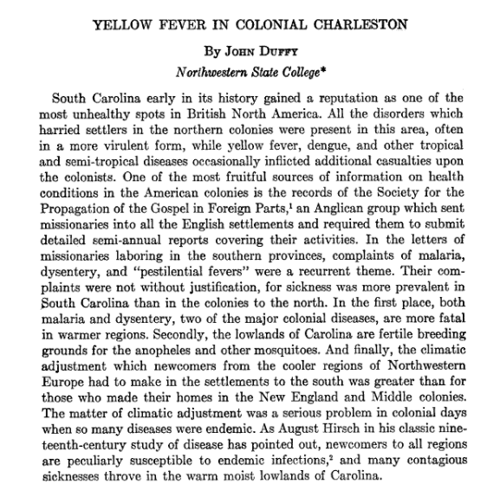
Document 3
John Duffy, “Yellow Fever in Colonial Charleston.” The South Carolina Historical and Genealogical Magazine, vol. 52, no. 4, South Carolina Historical Society, 1951, pp. 189–97, http://www.jstor.org/stable/27571297.

Slide 5
Document 4
From David E. Whisnant and Anne Mitchell Whisnant, Black Lives and Whitened Stories: from the lowcountry to the mountains (National Park Service 2020), 59-60.
In reading available...accounts of the Charleston-to-Flat Rock trek, one would conclude that around 1830 it rather suddenly occurred to dozens of wealthy, white, elite, formerly rather comfortably home-bound Charlestonians to assemble their Black house staffs, roll out their elegant carriages, hitch up the thoroughbreds with costly harnesses, and hie themselves to the mountains of western North Carolina in the summertime, in search of cool and healthful breezes, relatively cheap land, and spend “the season”—Charleston-style—nestled within picturesque forested landscapes.
{Historian Brewster} focused his analysis on the process as a necessary response to the advent of “the sickly season” on the plantations in and around Charleston. That season as he described it reached from as early as April through “the first hard frost” sometime in late October or even into November—more or less on each end, depending upon the locale, the families involved, the year, and turns in the weather. Whenever it came and however long it lasted (or was thought to last), “the sickly season,” Brewer observed, “precipitated an annual migration that carried planter families and planter society far afield in search of more salubrious and congenial residences or resorts.” Similarly, where they sought such places varied greatly over the years.
“The first main route,” as Brewster described it nearly seventy-five years ago, was the Saluda Gap Road, … a part of the state road from Charleston to Columbia and Greenville, … completed … in the years following 1825 as a result of the clamor of the up-country residents and the influence in the Legislature of the lowcountry visitors. The two Carolinas co-operated in building the turnpike section of the road over the mountains. In North Carolina [it] was built by the Buncombe Turnpike Company… [Its] first toll gate … opened in 1827. Crossing the top of the mountain, Brewster said, “the low-country migrants and travelers … found new sites for summer residences, new resorts to be patronized or developed, and new scenery that was a revelation to them.”

Slide 6
Document 5
Memminger Era
In the mid eighteen-twenties, Flat Rock became a popular summer destination because it offered release from the oppressive heat and the perfect climate to recover from illnesses. Many of its summer inhabitants were travelers from Charleston, South Carolina. Of the wealthy travelers from Charleston was Christopher Gustav Memminger, builder of what is today Connemara.
Memminger worked as a lawyer in Charleston, SC and gained prominence as the Secretary of Confederate Treasury during the Civil War. He established the property in 1836 to use as a vacation home with his family to escape the heat and insects that inhabited the South Carolina lowland during the summer time. He called the estate “Rock Hill” due to the exposed rock faces throughout the property. By the outbreak of the Civil War, Rock Hill included the Main House, Kitchen, and two surrounding slave quarters. The 1850 census taken in Charleston indicates that Memminger had twelve slaves. The two slave residences closest to the main house likely housed cooks, maids, and butlers for the family. The 1860 Henderson County census listed six male slaves in Memminger’s possession. Memminger resigned from his post in 1864 and retreated to Rock Hill. Shielded from battle by the mountains, Flat Rock, however, did not escape the brutality of war. Memminger, his family, and his friends used the place as a hideout due to the large presence of “Bushwhackers” and the lack of civil or military law in the area. Mansions in the area were raided, but there is no recorded account of Bushwhackers entering Rock Hill.
The Civil War ended and Memminger returned to Charleston to continue his law practice. After Memminger’s death, Rock Hill was sold to Colonel William Gregg, a native of South Carolina and former Confederate soldier. Though he owned Rock Hill for ten years, he never occupied it.
“History of Connemara.” National Parks Service, U.S. Department of the Interior, 22 Oct. 2021, https://www.nps.gov/carl/learn/historyculture/history-of-connemara.htm.

Slide 7
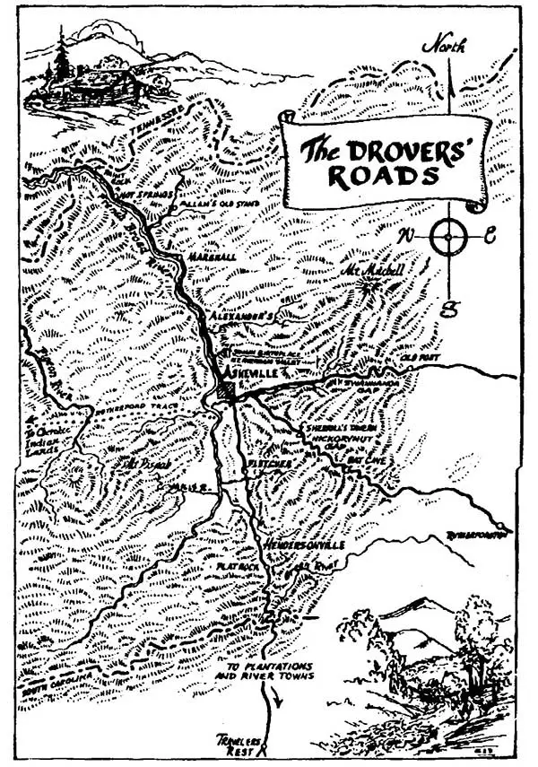
Document 6.1
“The drover’s road through southwestern North Carolina connected the region to Charleston and Savannah. It was a route of settlement in the early 19th century for many Scots-Irish families, as well as the site of cattle, swine, and sheep drives that were so important to the local economy.”
“Early Immigration to Western NC.” Historic Toxaway: A Storied Community. Early Immigration to Western NC - Historic Toxaway Foundation

Slide 8
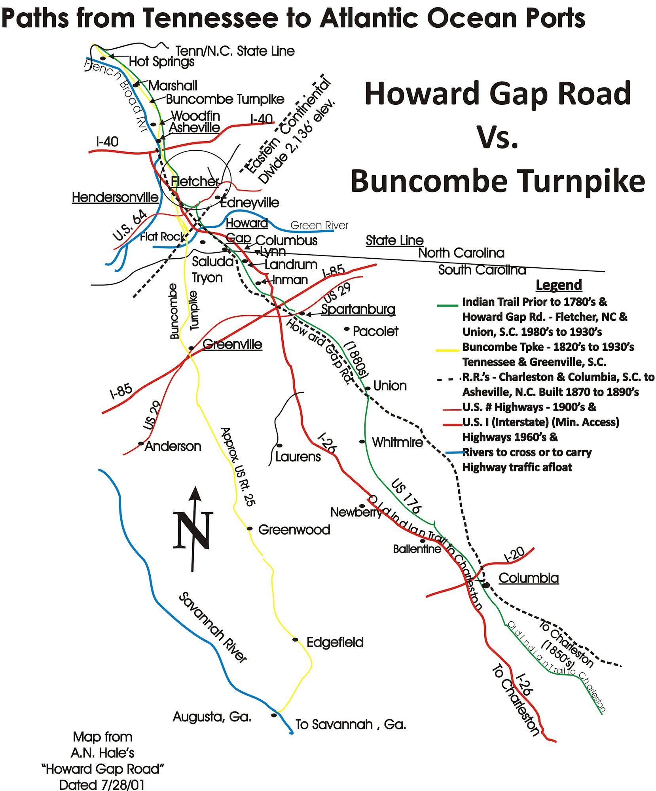
Document 6.2
Map of Howard Gap Road. Arthur N. Hale, “History of Howard Gap Road in North and South Carolina.” Polk County Historical Association, 2001.

Slide 9
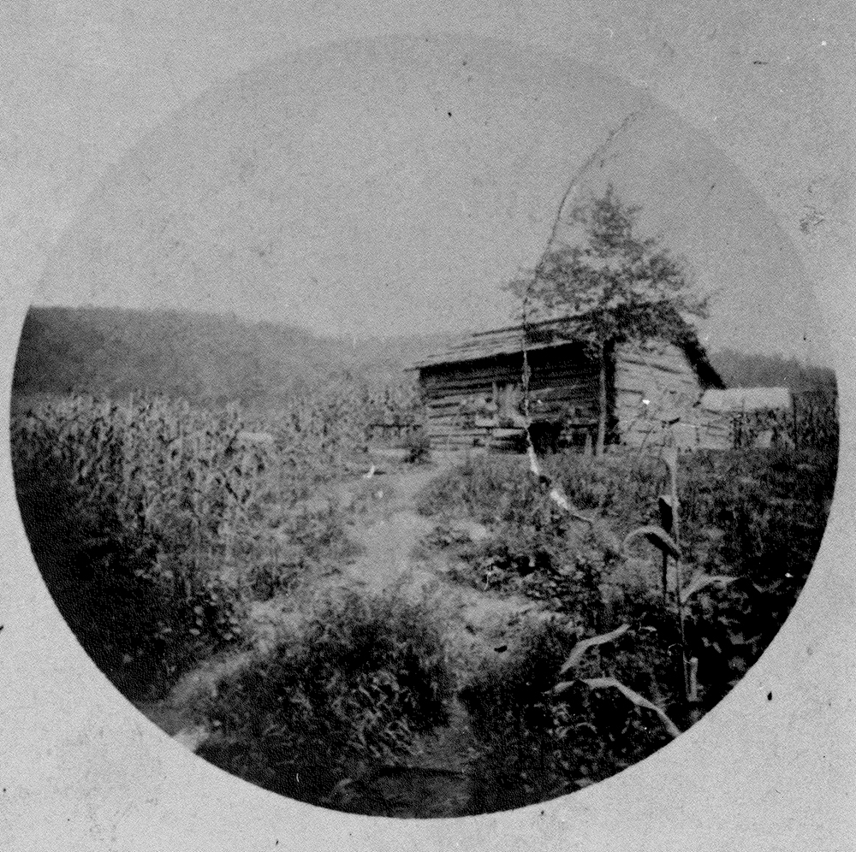
Document 7
“Housing for enslaved persons during the Memminger ownership of the property, when it was known as Rock Hill.”
Ballard Family Photograph Collection at Carl Sandburg Home National Historic Site. Gallery Item Display (nps.gov)

Slide 10
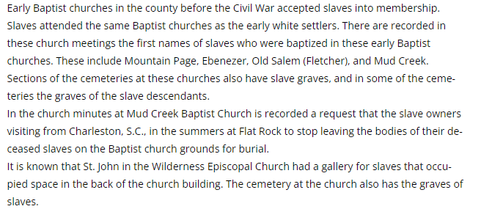
Document 8
“Slavery.” Henderson Heritage, 10 Oct. 2021, https://hendersonheritage.com/slavery/.

Slide 11
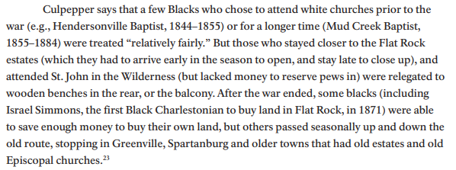
Document 9
From David E. Whisnant and Anne Mitchell Whisnant, Black Lives and Whitened Stories: From the Lowcountry to the Mountains (National Park Service 2020), 217.

Slide 12
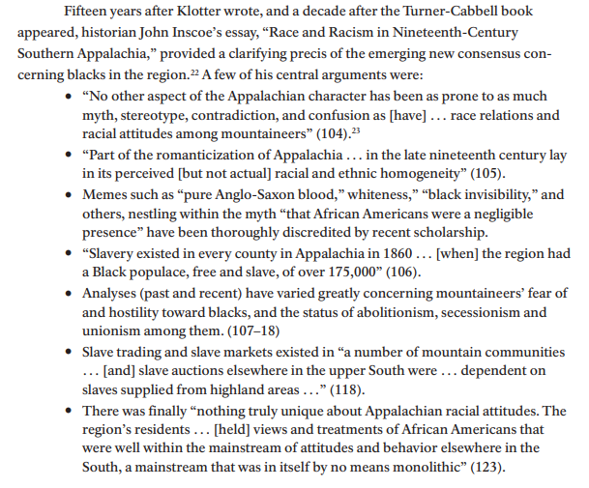
Document 10
From David E. Whisnant and Anne Mitchell Whisnant, Black Lives and Whitened Stories: From the Lowcountry to the Mountains (National Park Service 2020), 71

